Slide 1
Homework #2
Gage Gutmann
https://app.powerbi.com/Redirect?action=OpenApp&appId=1302c119-da8c-4a88-a699-d2c48102d921&ctid=2ba33407-5ccc-4940-bd16-ae154f04c3ca

Slide 2
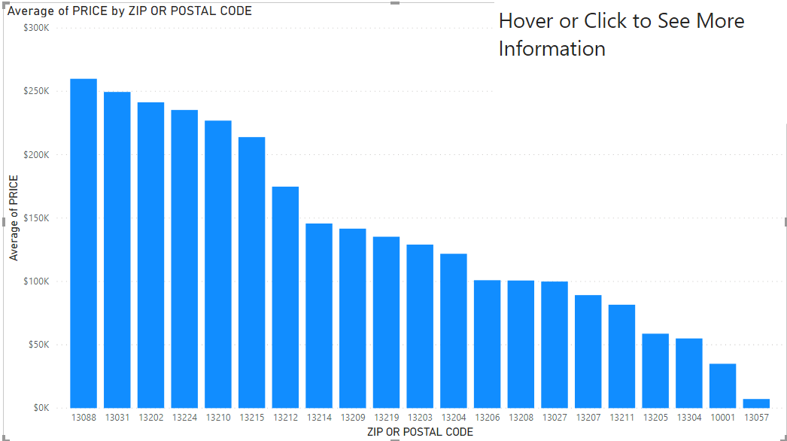
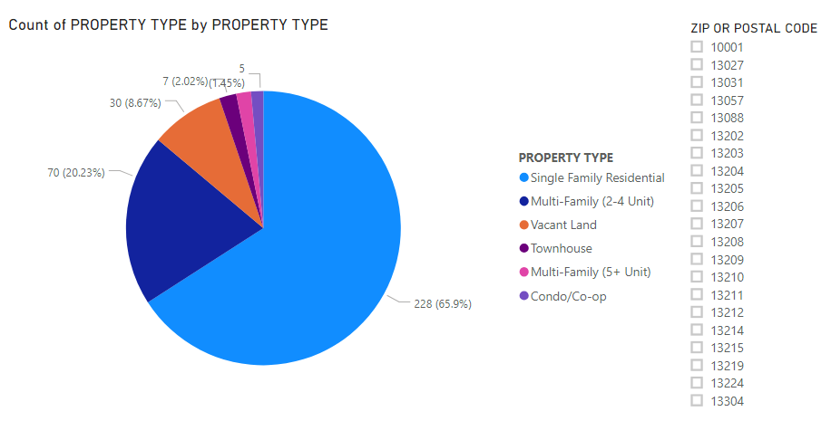
Zip Code and Property Type Analysis
Zip Code Analysis
Property Type Analysis

Slide 3
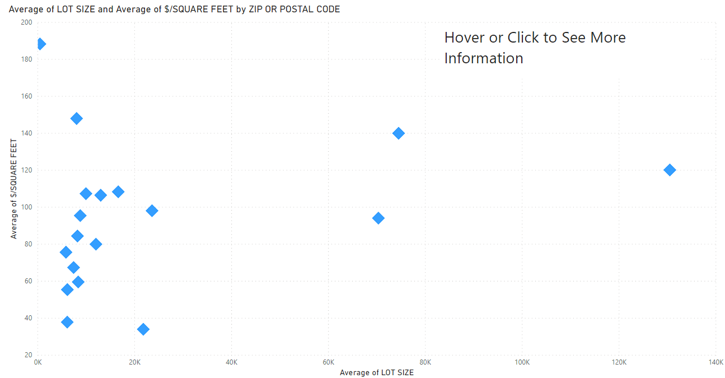
Lot Size and $/Square Feet Analysis

Slide 4
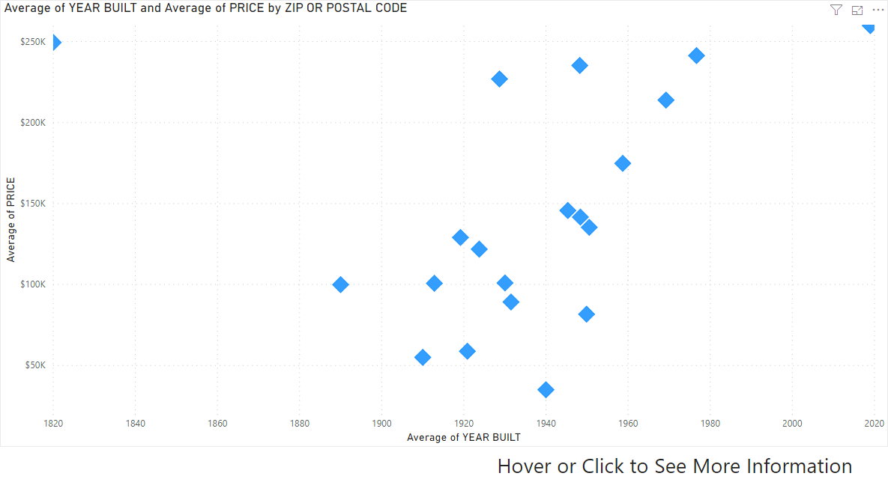
Year Built Analysis

Slide 5
What is the best zip code to look for a house in Syracuse?
A customer wants a good lot size to $/square foot ratio
But, they also want a house that is not too old so that they don’t have to do too much maintenance.
They want to get a good price and a property where they can raise their family
Let’s look at different zip codes, first taking into account the lot size to $/Square foot and the year built.
From there we can narrow down zip codes to look at average prices and the type of property.

Slide 6
Looking at the average lot size with the average $/square foot per zip code, the best ratios are at 13212, 13215, and 13031

Slide 7
If we look at this chart of average year built with price, we can compare ratios again. The best ratios are with 13212 and 13215. Lets look at them further

Slide 8
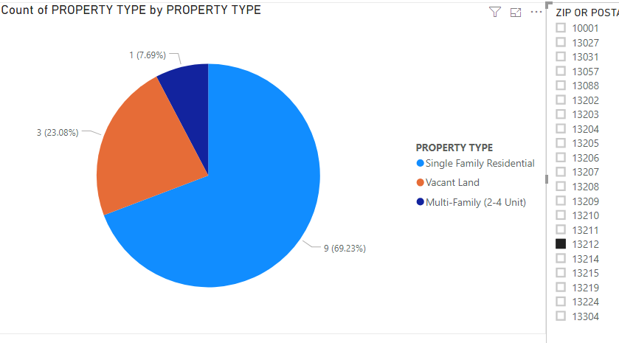
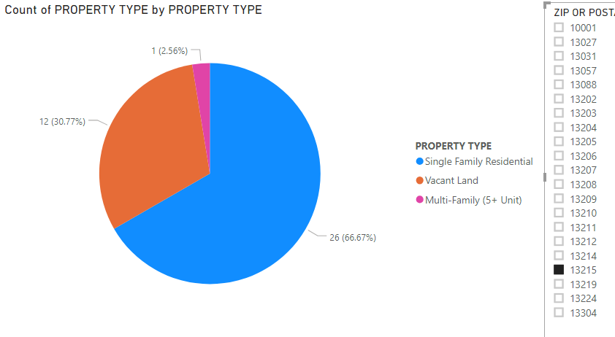
Property Type Comparison(Filtered by Zip)
13212
13215
Has more Single Family Residentials as well as Multi-Family
Has more Vacant Land to build upon

Slide 9
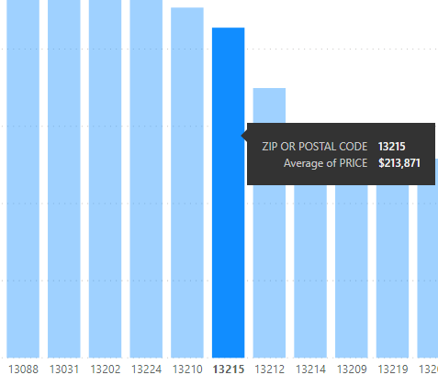
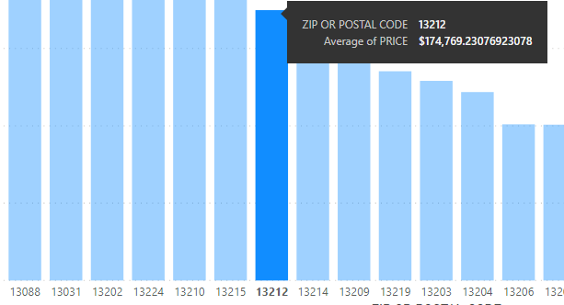
Average Price
The price of these two are similar when compared to each other, but looking closely, 13215 has an average price of almost $35,000 more.

Slide 10
Conclusion
The best two zip codes based on Lot Size and Year Built are 13212 and 13215.
When compared, 13215 has a slightly higher average year built and lot size.
However, it does have less options in regards to single family property type, and has an average cost of $35,000 more than 13212.
Because of more potential options and pricing, 13212 would be the better and safer option to look for a house.

